Slide 1


Monitoring Athletes Performance Through Wearable Devices
Industry project
Group-13
Client: Ollie Allan | Supervisor: Milad Chenaghlou
The Team:
Lin Mi
Tingli Qiu
Spoorthi Suresh Avvanna
Chitra Naga Durga Sindhusha Veluguleti
Yuhan Zhao

Slide 2

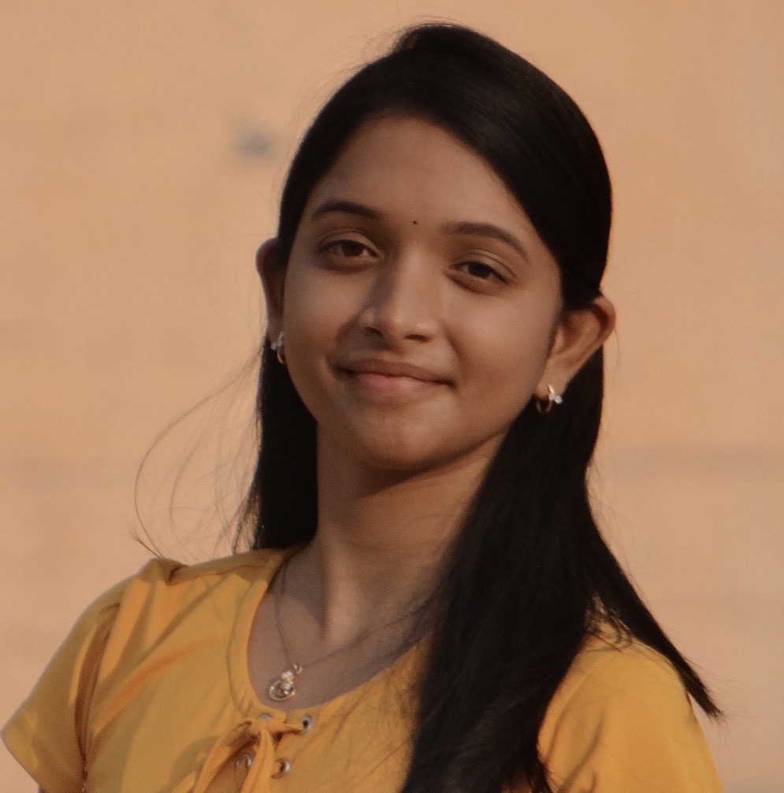



Overview
Our Team
Tingli
Sindhusha
Lin
Spoorthi
Yuhan
Developer, Architect & Data Scientist
Analyst & Data Scientist
Researcher & Data Scientist
Subject Matter Expert, Process Master & Data Scientist
Data Scientist

Slide 3
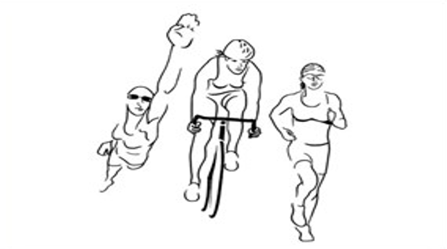
Overview
Overview
1
2
Introduction
Key question
Description of the problem domain
Describes the key question being solved
3
Project Pipeline
4
Related work
An overview of the project
An insight into how the industry is handling the problem
5
6
7
EDA & System Design
ML models & Results
Recommendations
A summary on the data exploration
A succinct description of models and their results
Key takeaways and future steps

Slide 4



Introduction
Introduction
Coaching Mate Pvt. Ltd
Decision making
Training
Australia’s leading multisport coaching Business
Providing services for over 280 athletes
Develop programs for athletes to compete in sporting events
CoachingMate software to deliver training instructions
Daily sessions planned by the coach
It is a combination of multiple activities

Slide 5
Introduction
Key data science research question introduced?
Sparse data
Inconsistent data capture for every athlete
Sparse data
Inconsistent data capture for every athlete
Current State
Future State
Garmin watch to capture data
Expertise based training
Gap
Garmin watch to capture data
Expertise based training
Cleaned data
Over-training or Under-training?

Slide 6







Introduction
Project Pipeline
Not good enough
Data
Data exploration
Data cleaning
Data labelling
Train model
Evaluating model
Results

Slide 7

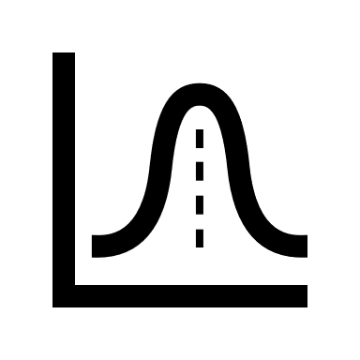
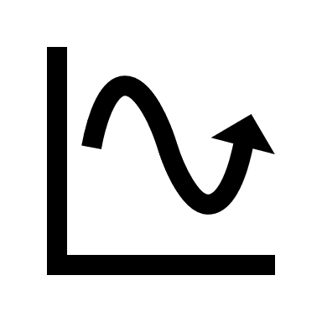

Introduction
Related Work
Metrics
Physiological
Heart Rate Variability
Psychological
Mental fatigue
1. Rating of Perceived Exertion (RPE)
• Estimates the level of exertion
• Highly subjective
• Measured using a Borg scale.
2. Kinetic and Kinematic statistics
• MU sensors to check for body and limb
• acceleration
• Heart Rate to predict for Training Stress
• Scores
3. Fitness-Fatigue Bannister Model
• Difference between a negative function
(‘fatigue’) and a positive function (‘fitness’)
4. Machine Learning Methods
• GBRT
• ANN
• SVM
• LASSO and ElasticNet
5. Performance prediction
Running
• Pace
• Heart rate
• Cadence
Swimming
• Body fitness (lung capacity)
• Swimming technique (Glide, Distance per stroke)
Cycling
• Body features
• Cycling speed
• Skin temperature

Slide 8
Introduction
Exploratory Data Analysis
Data Exploration
Data Cleaning
Feature Engineering
Understanding Garmin features
Univariate analysis
Bivariate analysis
Formatting data
Missing value & outlier treatment based on activity type
Activity based feature extraction (e.g., rTss & sTSS)
Custom features (e.g., activities per week) for modelling

Slide 9
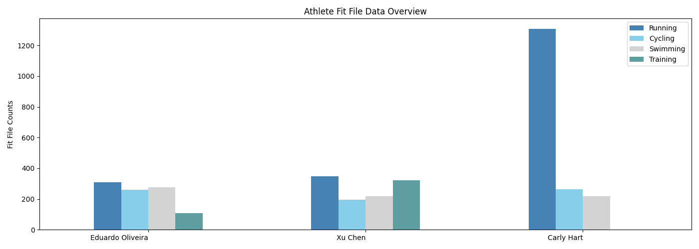
Introduction
Exploratory Data Analysis
~4 years of data
~44 Columns
12 athletes
(0.1-1)k data entries per athlete
Training Stress Score*
*only 12% of the TSS scores are valid

Slide 10
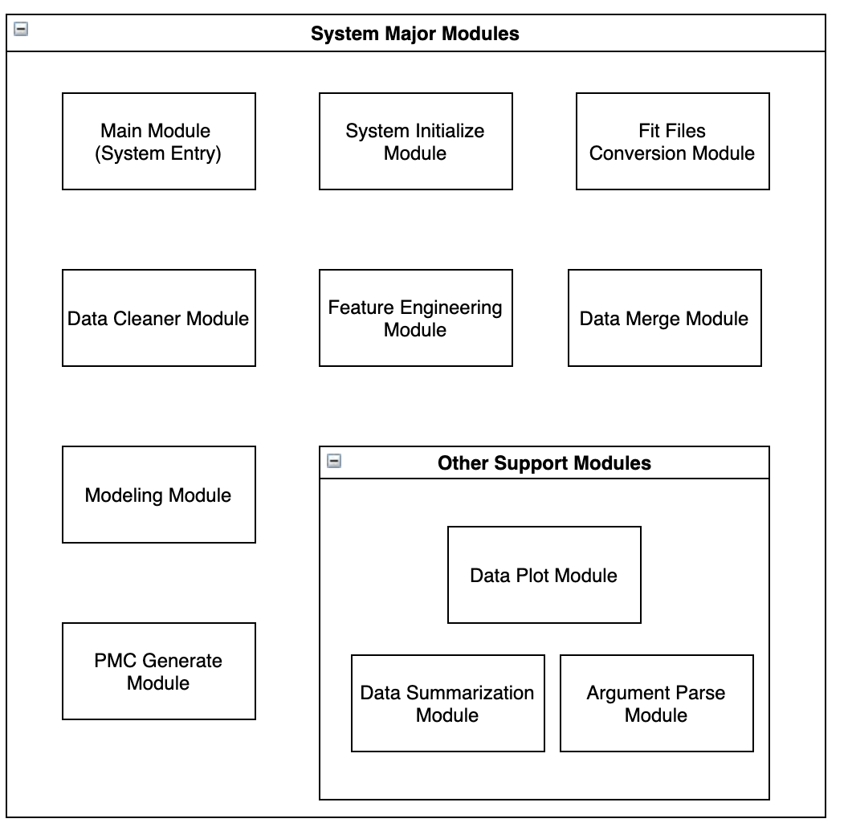
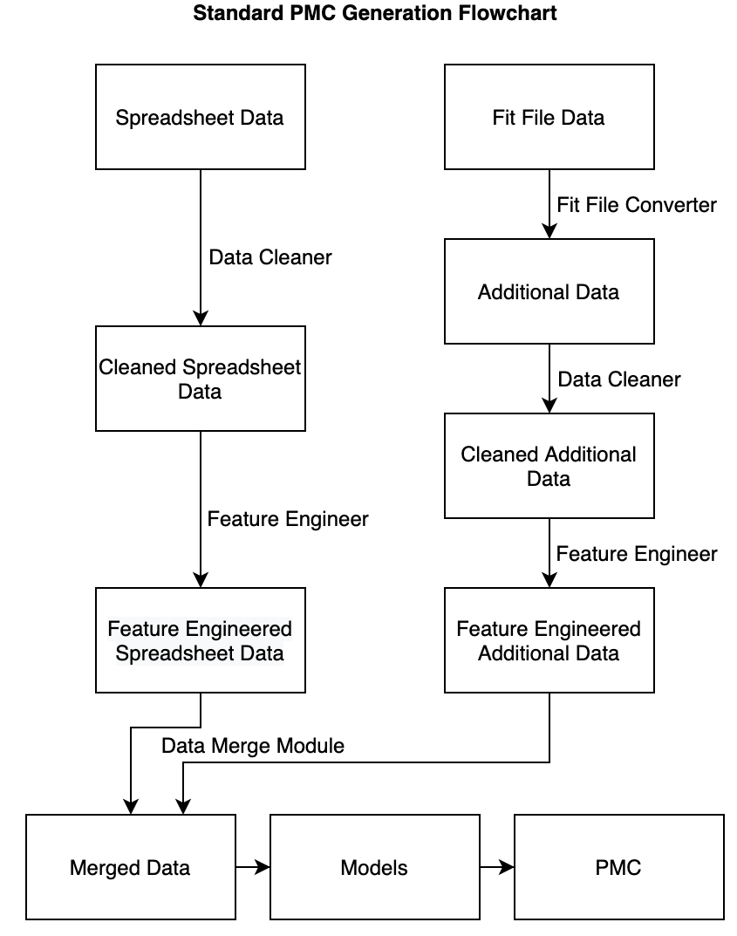
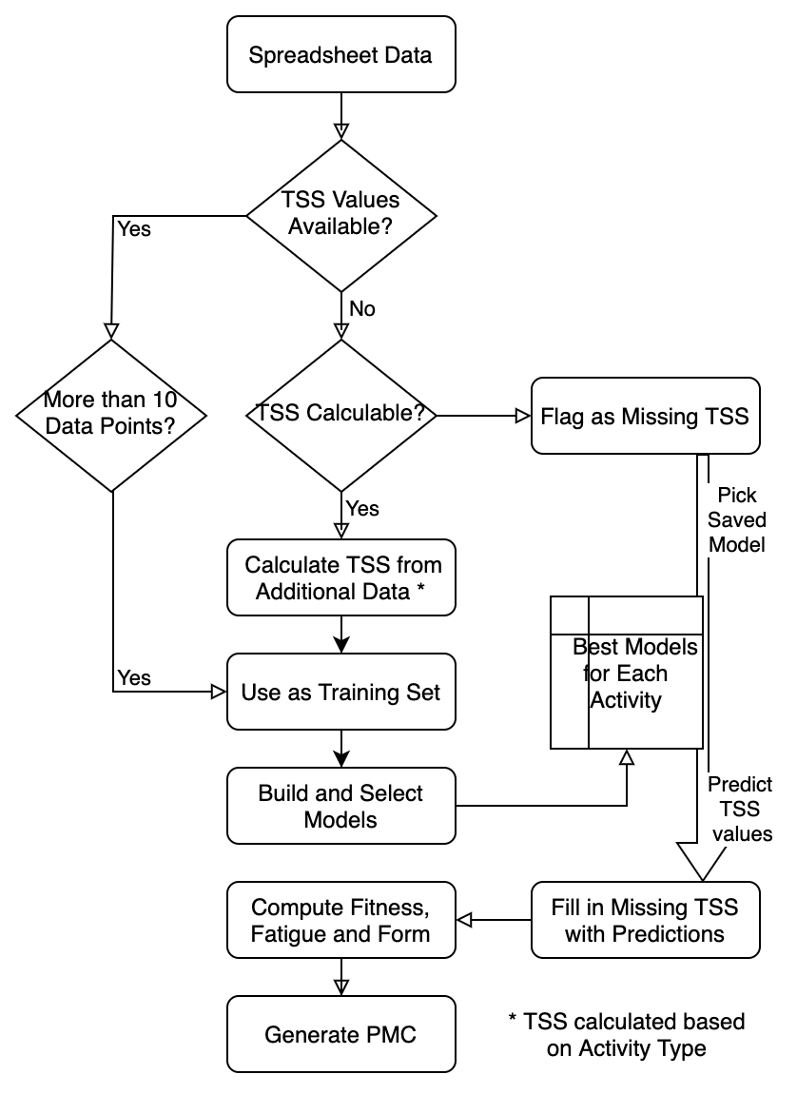
Introduction
System Sketch Map

Slide 11
Introduction
Machine Learning Models
Owing to the large dimensionality and fewer training points in the dataset, Lasso was used in order to penalize the less important features and predict for TSS linearly.
Machine Learning Models
Linear regression
Neural Network
Random Forest
AdaBoost
XGBoost
As we have high dimensional and sparse data set, XGBoost with L1 regularization was used to reduce the model complexity. It uses both first and second derivatives for loss function.
Given TSS, Fatigue/Fitness are time series data, we use LSTM to keep past information while processing the current.
Adaptive. It changes the weights of samples while processing.
Random Forest lies in its idea of the combination of “bootstrap aggregating” and “random subspace”. It ensembles several regression trees and is not sensitive to outliers.

Slide 12
Introduction
Results
Average models*
ADB
NN
LR
RF
XGB
Best models*
MAE: 11.76
R²: 0.796
MAE: 21.86
R²: 0.72
MAE: 15.8
R²: 0.795
MAE: 20.43
MAE: 17.4
R²: 0.489
R²: 0.764
*All models were subjected to cross-validation and parameter tuning

Slide 13
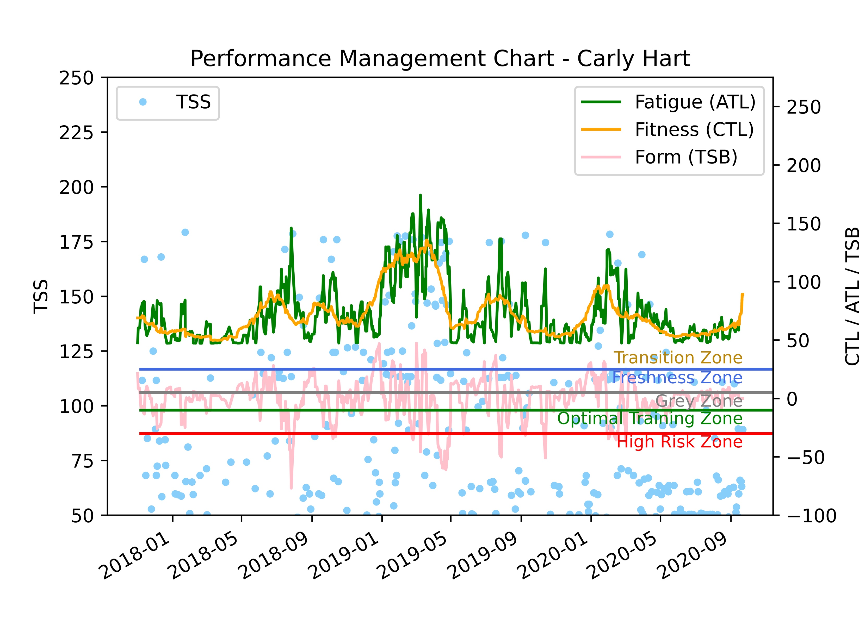
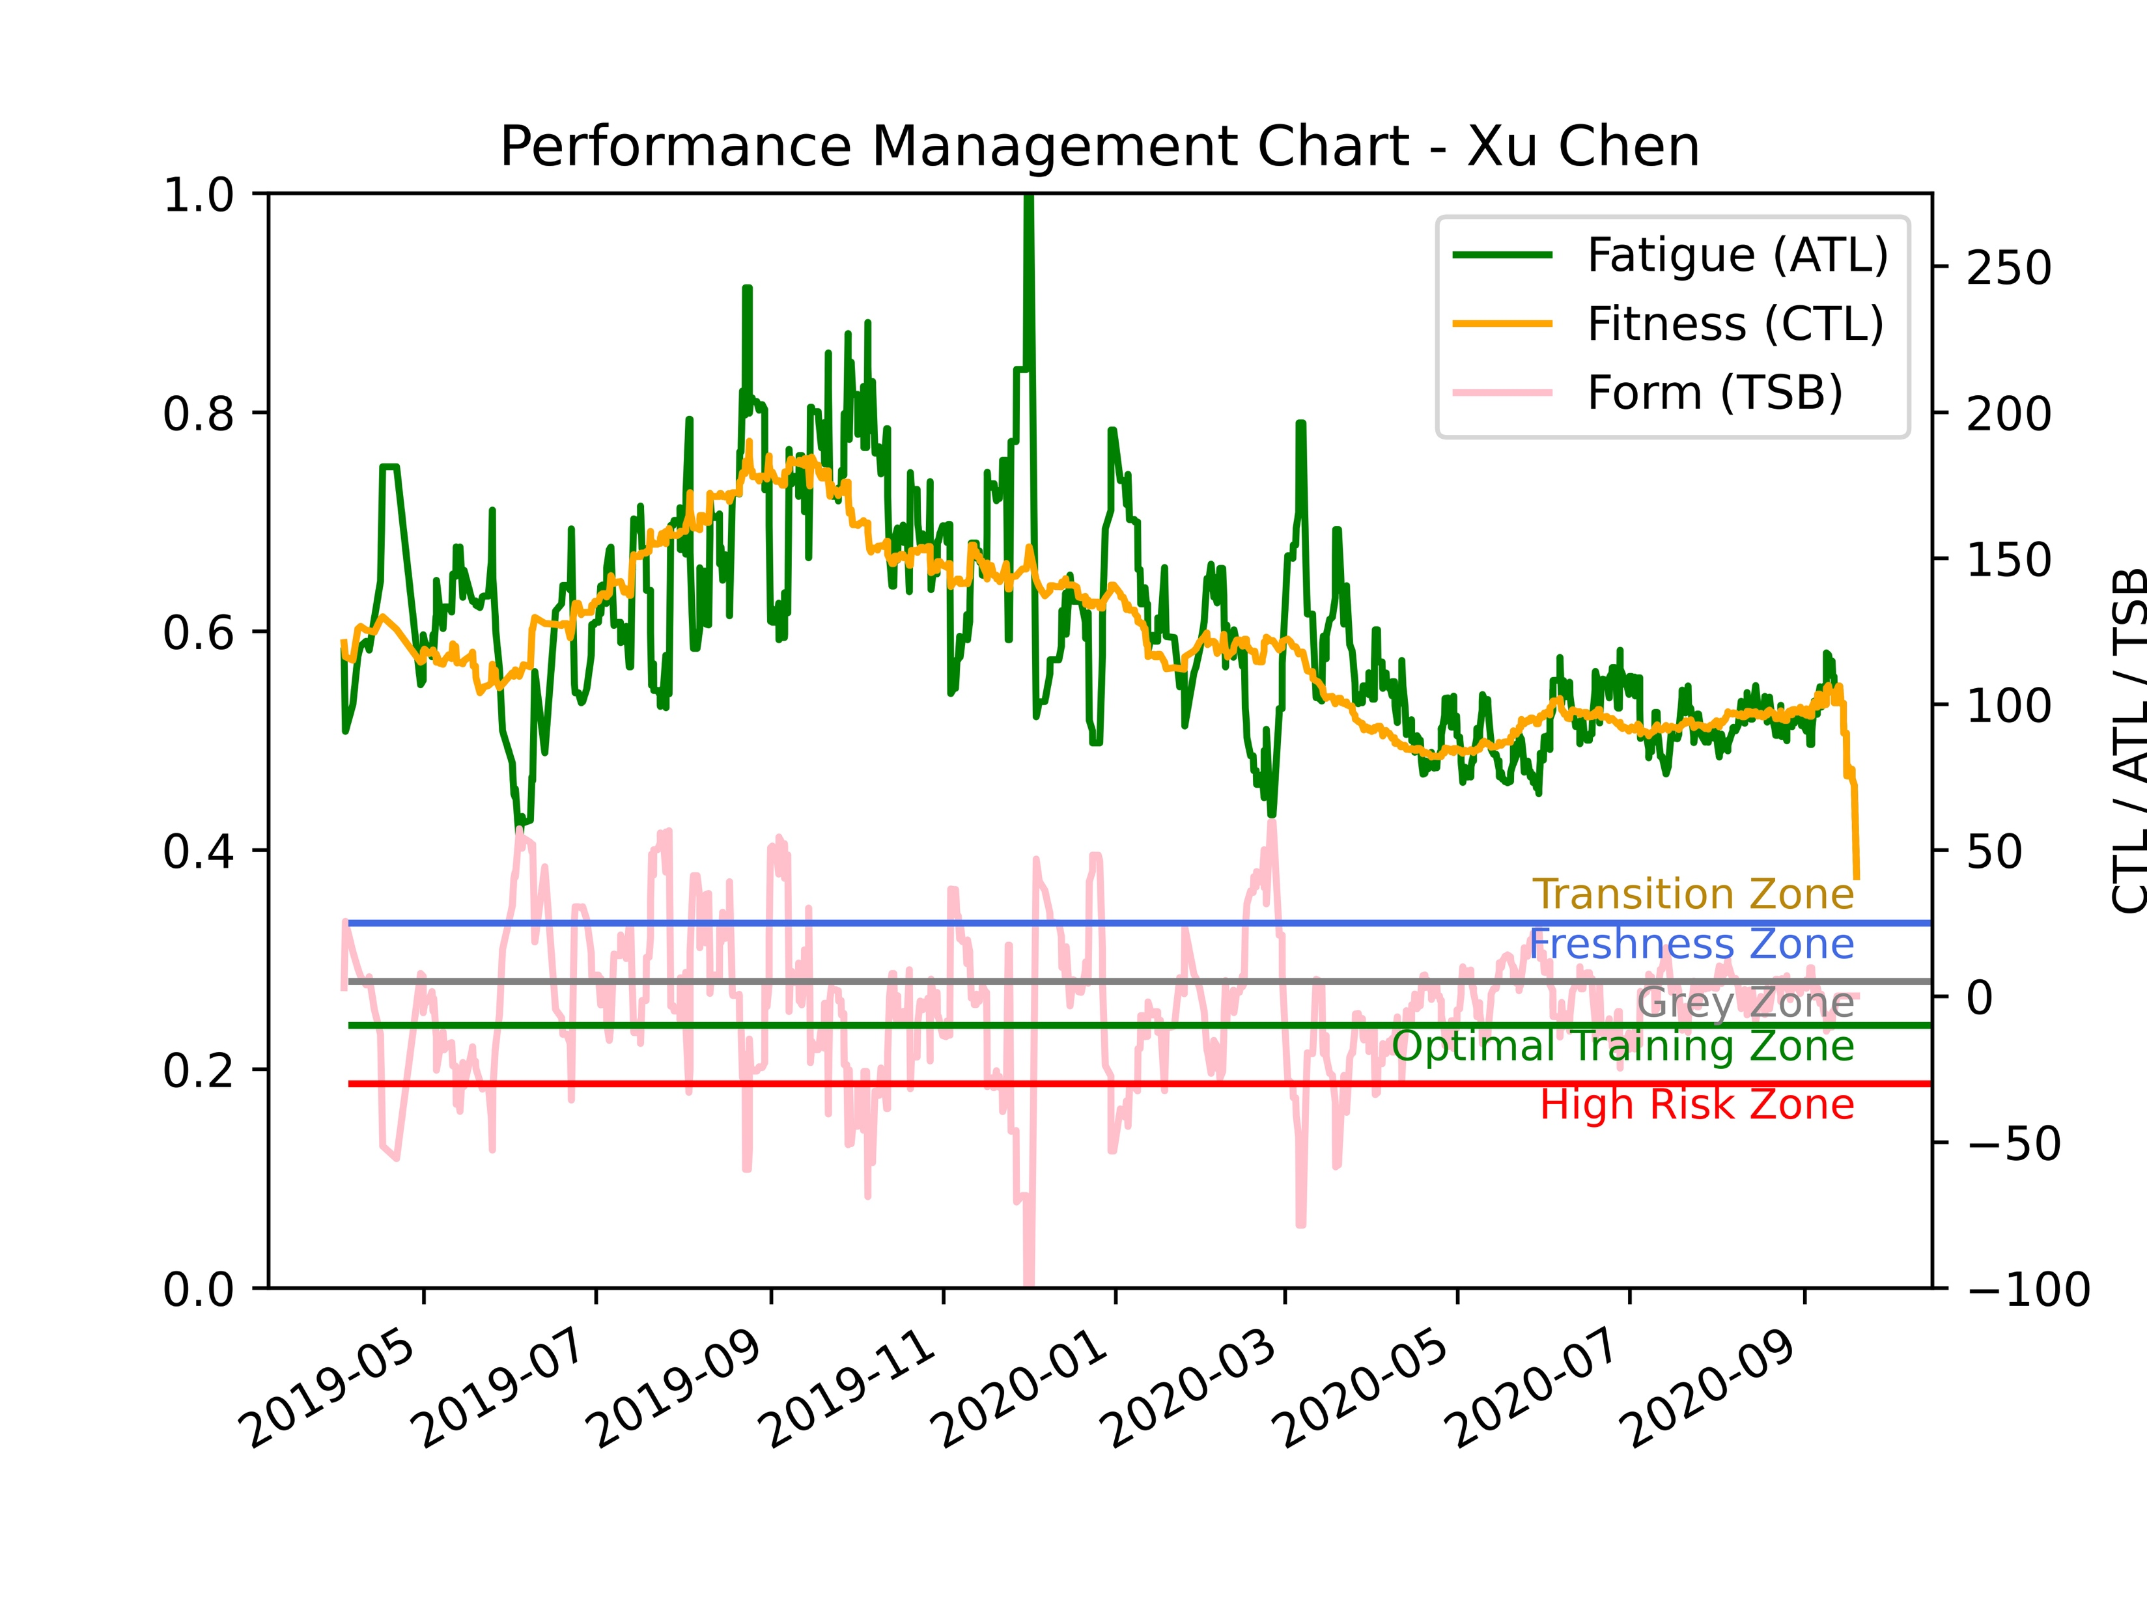
Introduction
PMC
MAE:11.76
R²:0.97
MAE:21.86
R²:
MAE:15.8
R²:0.95
MAE:20.43
MAE:17.4
R²:0.90
R²:0.764

Slide 14




Introduction
Recommendations
Amongst the ~44 columns Distance, min Temp, No. of unique weekly activities, Avg. HR, Stride length and Vertical ratio are important for running
Calories, No. of laps, Max. Speed, Elev. Gain, Max. power, Max HR and Max. Bike Cadence are important for Cycling
The PMC chart can be improved by formulating a methodology to compute TSS for Strength Training activity and better data capture for all other activities, especially swimming
Performance prediction could be the next stage

Slide 15
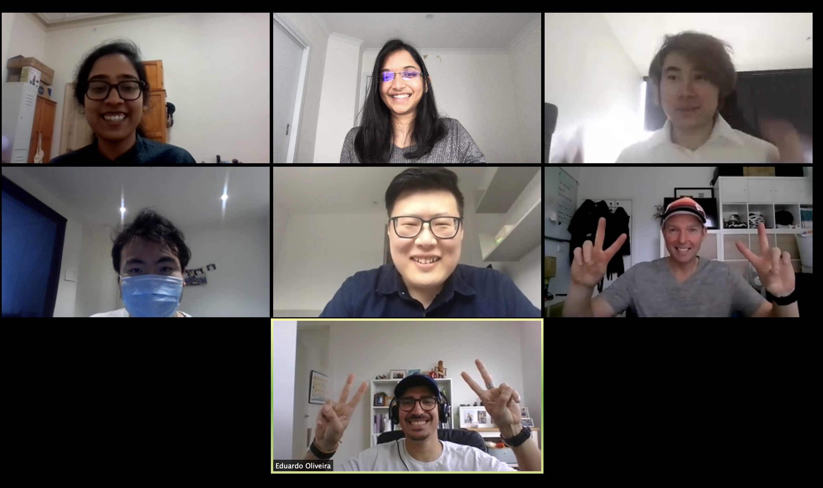
Introduction
Group Photo
MAE:11.76
R²:0.97
MAE:21.86
R²:
MAE:15.8
R²:0.95
MAE:20.43
MAE:17.4
R²:0.90
R²:0.764

